Slide 1

Integrating Adobe Firefly with Brand AI Chatbot
A Strategic Approach for Luminar
James Laughlin – Adobe Inc.

Slide 2
Understanding Luminar’s Needs

Slide 3

Understanding Luminar’s Needs
Key needs:
On-brand text/image/video generation
Secure and scalable AI integration
Elegant integration with existing/proposed systems
Key challenges:
Understanding the current AI architecture
Documenting all proposed requirements
Integrating Adobe’s AI tools with internal APIs, systems & any third-party solutions
Training the business on use of new AI tools
Notes:
Every successful integration starts with understanding the business needs,
and for Luminar, that means aligning technical capabilities with strategic goals
We’re going to spend a lot of time on this
This is foundational
Critical to the success of the project.
On-brand content is critical for maintaining identity across channels.
Security and scalability are non-negotiable,
You’re not just building tech – you’re building trust through seamless, secure integration.
If it doesn’t make the creative teams smile and the IT folks sleep at night, it’s not really a solution, right?

Slide 4
Overview of Firefly Services APIs

Slide 5
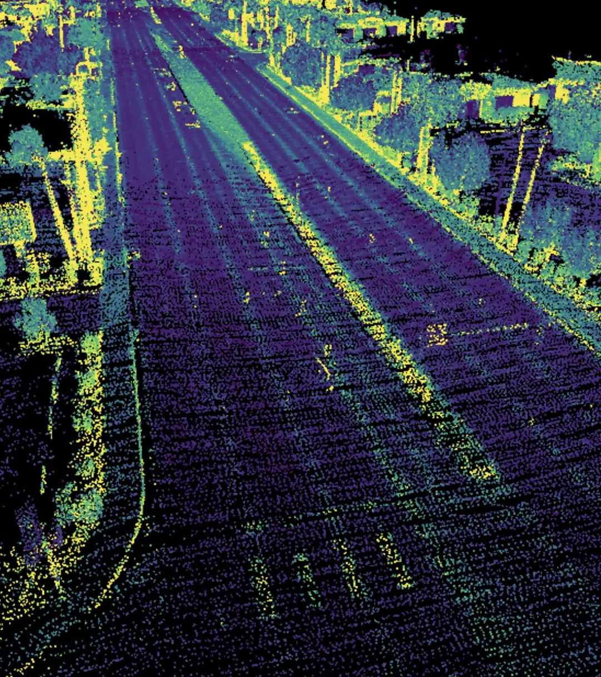
Overview of Firefly Services APIs
Firefly APIs enable image, vector, and template generation aligned with brand styles and voice.
Supports reference image styling and prompt-based content creation.
Ideal for automation, dynamic content, and branded asset/copy production.
Key capabilities: text-to-image, generative fill, template remixing, copy generation.
Seamless integration with Adobe Express, AEM, and Creative Cloud assets.
Notes:
Firefly APIs are the creative engine here,
providing a wide range of capabilities that are
as versatile as they are powerful.”
This is where we give your chatbot a double major in graphic design and creative writing.
Image, vector, and template generation
this is the core value of Firefly.
Its all available through the API
There’ also the seamless integration with Adobe’s other products
Express,
AEM
Creative Cloud
I like to think of this as giving your chatbot a superpower –
the ability to not just talk, but create."

Slide 6
Integration Strategy & Validation

Slide 7

Integration Strategy & Validation
Phase 0: Information gathering and documentation of requirements
Notes:
Integration Strategy & Validation
Integration is where the magic really happens – connecting all these moving parts into a seamless experience."
Personal Touch: "This is where we go from 'proof of concept' to 'proof of awesome.'"
Main Points:
Phase 0
is where we get our ducks in a row.
We do all the discovery and document all of the requirements

Slide 8
Integration Strategy & Validation
Phase 0: Information gathering and documentation of requirements
Phase 1: PoC with Firefly API (image generation) and prompt engineering.
Notes:
Slide 4: Integration Strategy & Validation
Integration is where the magic really happens – connecting all these moving parts into a seamless experience."
Personal Touch: "This is where we go from 'proof of concept' to 'proof of awesome.'"
Main Points:
Phase 0
is where we get our ducks in a row.
We do all the discovery and document all of the requirements
Phase 1 – Image Generation
is where we do our proof of concept for images
This will let us know if we’ve done a good job in phase 0

Slide 9
Integration Strategy & Validation
Phase 0: Information gathering and documentation of requirements
Phase 1: PoC with Firefly API (image generation) and prompt engineering.
Phase 2: Connect chatbot with internal gateway to route AI tasks.
Notes:
Slide 4: Integration Strategy & Validation
Integration is where the magic really happens – connecting all these moving parts into a seamless experience."
Personal Touch: "This is where we go from 'proof of concept' to 'proof of awesome.'"
Main Points:
Phase 0
is where we get our ducks in a row.
We do all the discovery and document all of the requirements
Phase 1 – Image Generation
is where we do our proof of concept for images
This will let us know if we’ve done a good job in phase 0
Phase 2
here we connect the PoC to your chatbot through your custom gateway
If there are performance issues with the gateway approach, we’ll uncover them here.

Slide 10
Integration Strategy & Validation
Phase 0: Information gathering and documentation of requirements
Phase 1: PoC with Firefly API (image generation) and prompt engineering.
Phase 2: Connect chatbot with internal gateway to route AI tasks.
Phase 3: Integrate LLM for on-brand text via fine-tuning or guardrails.
Notes:
Slide 4: Integration Strategy & Validation
Integration is where the magic really happens – connecting all these moving parts into a seamless experience."
Personal Touch: "This is where we go from 'proof of concept' to 'proof of awesome.'"
Main Points:
Phase 0
is where we get our ducks in a row.
We do all the discovery and document all of the requirements
Phase 1 – Image Generation
is where we do our proof of concept for images
This will let us know if we’ve done a good job in phase 0
Phase 2
here we connect the PoC to your chatbot through your custom gateway
If there are performance issues with the gateway approach, we’ll uncover them here.
Phase 3 – LLM for copy generation
is where we do for text what we did for images in phase 1

Slide 11
Integration Strategy & Validation
Phase 0: Information gathering and documentation of requirements
Phase 1: PoC with Firefly API (image generation) and prompt engineering.
Phase 2: Connect chatbot with internal gateway to route AI tasks.
Phase 3: Integrate LLM for on-brand text via fine-tuning or guardrails.
Phase 4: UI development and integration with existing interface.
Notes:
Slide 4: Integration Strategy & Validation
Integration is where the magic really happens – connecting all these moving parts into a seamless experience."
Personal Touch: "This is where we go from 'proof of concept' to 'proof of awesome.'"
Main Points:
Phase 0
is where we get our ducks in a row.
We do all the discovery and document all of the requirements
Phase 1 – Image Generation
is where we do our proof of concept for images
This will let us know if we’ve done a good job in phase 0
Phase 2
here we connect the PoC to your chatbot through your custom gateway
If there are performance issues with the gateway approach, we’ll uncover them here.
Phase 3 – LLM for copy generation
is where we do for text what we did for images in phase 1
Phase 4
We put a pretty face on it
Not just UI development – this is UX development
Seamless integration with existing UI
As easy as possible for your users to be up and running from the gun

Slide 12
Integration Strategy & Validation
Phase 0: Information gathering and documentation of requirements
Phase 1: PoC with Firefly API (image generation) and prompt engineering.
Phase 2: Connect chatbot with internal gateway to route AI tasks.
Phase 3: Integrate LLM for on-brand text via fine-tuning or guardrails.
Phase 4: UI development and integration with existing interface.
Validation: brand review, stakeholder feedback, performance tests.
Notes:
Integration Strategy & Validation
Integration is where the magic really happens – connecting all these moving parts into a seamless experience."
Personal Touch: "This is where we go from 'proof of concept' to 'proof of awesome.'"
Main Points:
Phase 0
is where we get our ducks in a row.
We do all the discovery and document all of the requirements
Phase 1 – Image Generation
is where we do our proof of concept for images
This will let us know if we’ve done a good job in phase 0
Phase 2
here we connect the PoC to your chatbot through your custom gateway
If there are performance issues with the gateway approach, we’ll uncover them here.
Phase 3 – LLM for copy generation
is where we do for text what we did for images in phase 1
Phase 4
We put a pretty face on it
Not just UI development – this is UX development
Seamless integration with existing UI
As easy as possible for your users to be up and running from the gun
Validation and UAT
Here we find out if the business has any tweaks they’d like to make
If we’ve done our job right there should be no surprises here
Although we do expect some tweaks to come up at this time

Slide 13
Maintenance & Scaling Considerations
Notes:
Finally,
Maintenance and Scaling considerations

Slide 14

Maintenance & Scaling Considerations
Automated testing pipelines for API and model updates.
Version control and fallbacks for Firefly APIs.
Monitoring via API gateway and usage dashboards.
Scalable storage for assets, caching strategies for high-demand prompts.
Plan for feedback loops to refine prompt engineering continuously.
Notes:
Finally,
Maintenance and Scaling considerations
Once it’s built, you have to keep it running smoothly – because scaling isn’t just about adding servers, it’s about building a smarter system."
automated testing,
version control,
and smart scaling when needed
To stay within financial limits.
you can’t just throw more servers and code at the problem – you need to be smart about it.

Slide 15
Proposed Architecture & API Management

Slide 16

Proposed Architecture & API Management
AI Chatbot → Internal API Gateway → Firefly Services & LLMs.
Custom API gateway allows routing, throttling, and observability.
Incorporates Adobe Express/AEM for content deployment.
Security: OAuth2, Adobe Identity integration, third-party SSO, rate limiting.
Scalable via containerized microservices or serverless (e.g., AWS Lambda, Azure Functions).
Notes:
Now, all this creativity needs a solid pipeline to flow through,
and that’s where the architecture comes in.
We need to know more about your API management Layer
What does it bring to the project?
Which of these does it handle?
Traffic Management and Load Balancing
Request Routing
Security Management
Request and Response Transformation
Caching
Logging and Monitoring
API Versioning and Lifecycle Management
Cross-Origin Resource Sharing (CORS) Management
Error Handling and Custom Responses
If it doesn’t handle all of these would it be wiser to use the AWS API Gateway?
Should we plan on using the AWS API Gateway in ADDITION to your API management layer?
Security
We support oAuth2
SSO through Adobe sign or your 3rd party SSO
Rate limiting – limits overuse due to DDoS
Think of this as the difference between a garden hose and a fire hose – we’re building the latter.

Slide 17
Chatbot Mockup

Slide 18
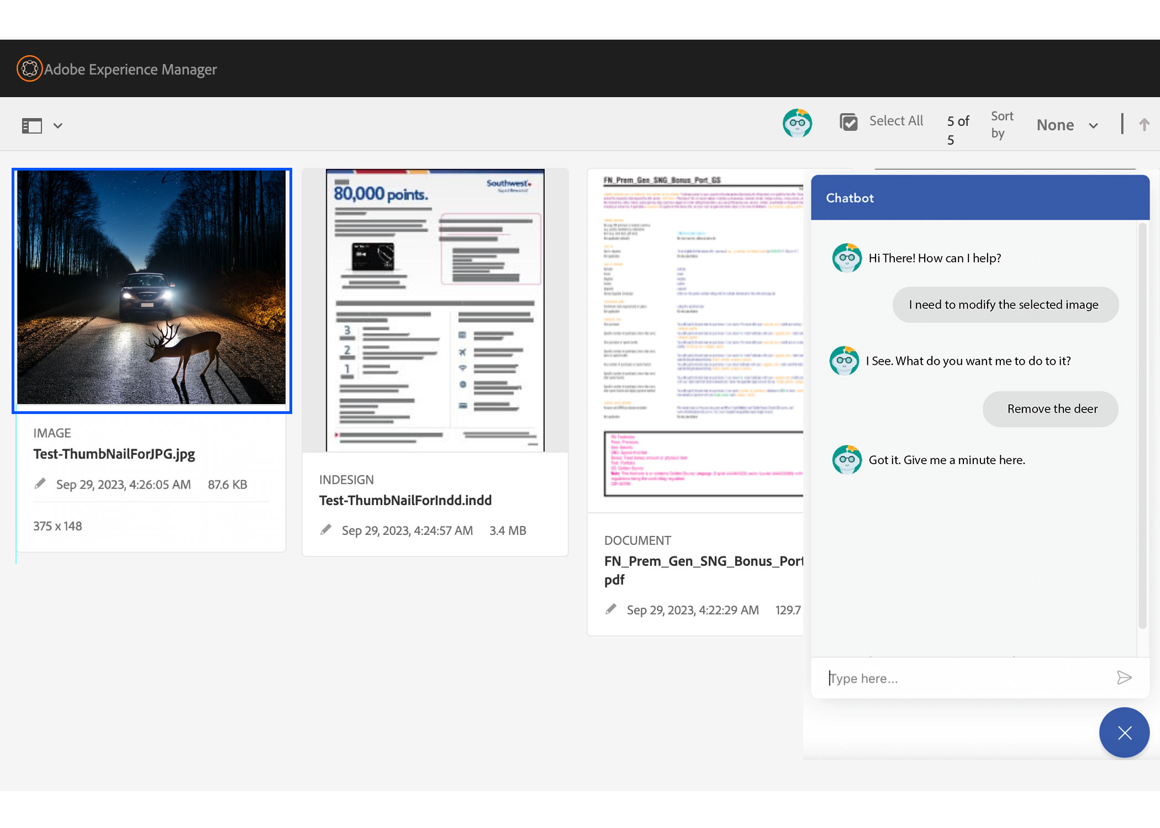

Slide 19
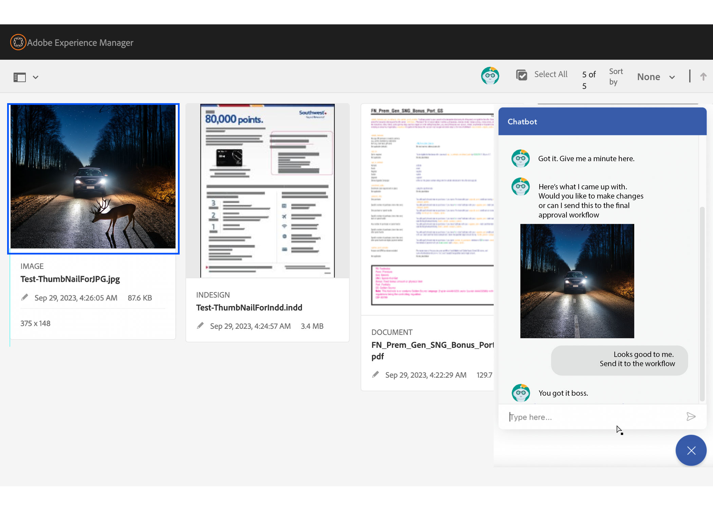

Slide 20
Architecture Diagram

Slide 21
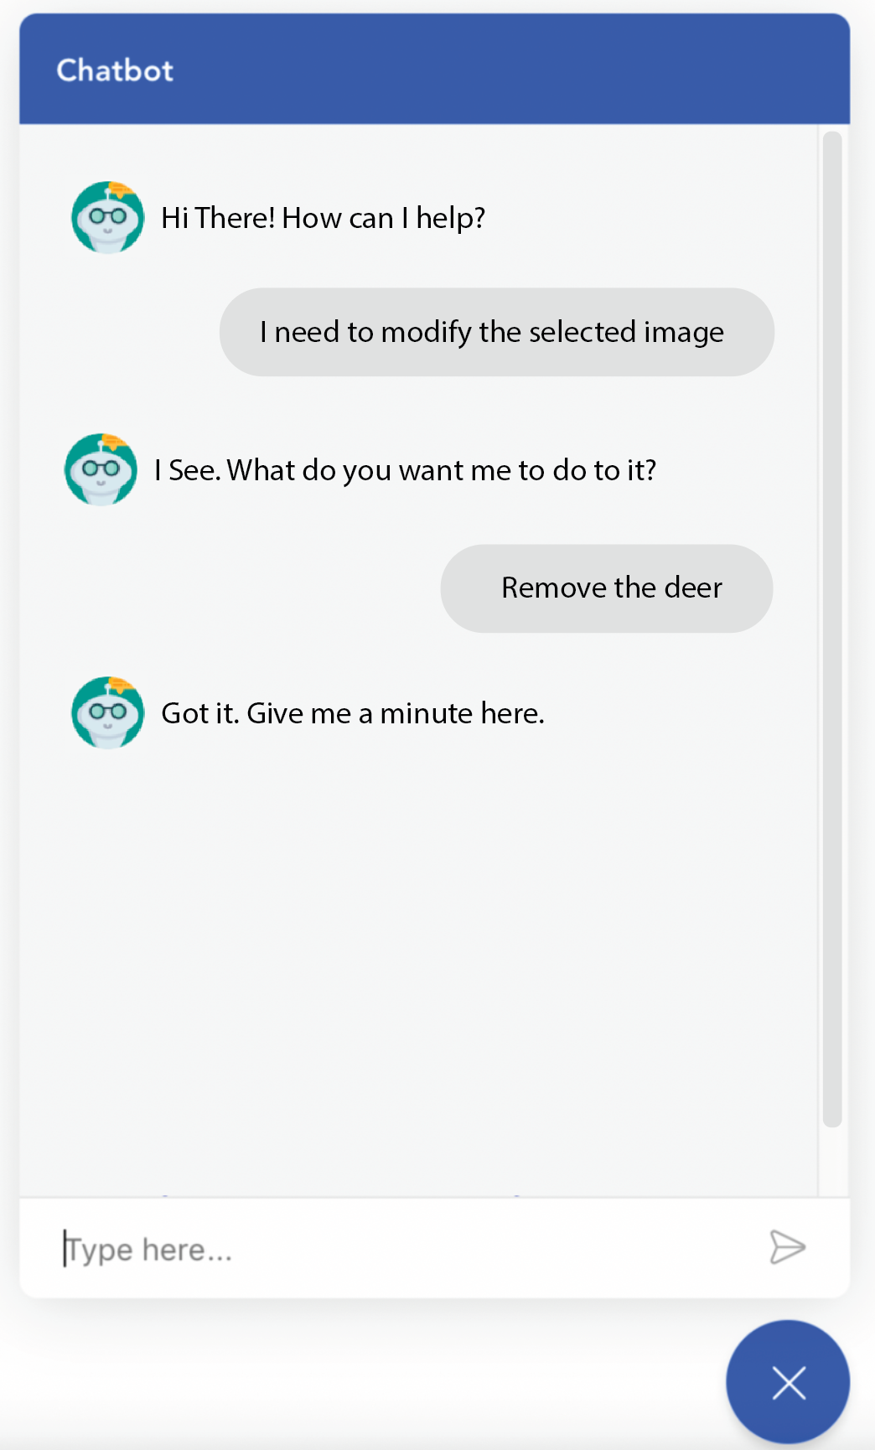
Proposed Architecture & API Management
AEM
AWS
Luminar API Gateway
Prompts, Images and Feedback
Chatbot Logic
AWS Comprehend, Rekognition, SageMaker
On-Brand Filtered Responses
Brand Filter
Firefly API (Vision)
OpenAI API (LLM)
3rd Party Training APIs
On-brand approval workflow (existing)

Slide 22
Proposed Architecture & API Management
AEM
AWS
Luminar API Gateway
Prompts, Images and Feedback
Chatbot Logic
AWS Comprehend, Rekognition, SageMaker
On-Brand Filtered Responses
Brand Filter
Firefly API (Vision)
OpenAI API (LLM)
3rd Party Training APIs
On-brand approval workflow (existing)
Notes:
User interacts with chatbot. Provides prompts and/or reference images.

Slide 23
Proposed Architecture & API Management
AEM
AWS
Luminar API Gateway
Prompts, Images and Feedback
Chatbot Logic
AWS Comprehend, Rekognition, SageMaker
On-Brand Filtered Responses
Brand Filter
Firefly API (Vision)
OpenAI API (LLM)
3rd Party Training APIs
On-brand approval workflow (existing)
Notes:
Prompt and/or images are sent through the brand filter to the Firefly and/or LLM API for processing.
The brand filter either has, or begins building contextual understanding of the request

Slide 24
Proposed Architecture & API Management
AEM
AWS
Luminar API Gateway
Prompts, Images and Feedback
Chatbot Logic
AWS Comprehend, Rekognition, SageMaker
On-Brand Filtered Responses
Brand Filter
Firefly API (Vision)
OpenAI API (LLM)
3rd Party Training APIs
On-brand approval workflow (existing)
Notes:
Firefly/LLM API provides responses to the brand filter which either approves or rejects it based on it’s level of knowledge of the brand guidelines.

Slide 25
Proposed Architecture & API Management
AEM
AWS
Luminar API Gateway
Prompts, Images and Feedback
Chatbot Logic
AWS Comprehend, Rekognition, SageMaker
On-Brand Filtered Responses
Brand Filter
Firefly API (Vision)
OpenAI API (LLM)
3rd Party Training APIs
On-brand approval workflow (existing)
Notes:
If the brand filter rejects the response, it’s sent back to the Firefly/LLM API for reprocessing

Slide 26
Proposed Architecture & API Management
AEM
AWS
Luminar API Gateway
Prompts, Images and Feedback
Chatbot Logic
AWS Comprehend, Rekognition, SageMaker
On-Brand Filtered Responses
Brand Filter
Firefly API (Vision)
OpenAI API (LLM)
3rd Party Training APIs
On-brand approval workflow (existing)
Notes:
Once satisfied that the content meets brand guidelines as it is aware of them, the brand filter returns the response copy or image to the user via the chatbot UI.

Slide 27
Proposed Architecture & API Management
AEM
AWS
Luminar API Gateway
Prompts, Images and Feedback
Chatbot Logic
AWS Comprehend, Rekognition, SageMaker
On-Brand Filtered Responses
Brand Filter
Firefly API (Vision)
OpenAI API (LLM)
3rd Party Training APIs
On-brand approval workflow (existing)
Notes:
At this point the user has the option of accepting the results and passing them off to the final approval workflow, or asking the AI to make further edits, starting the process over.

Slide 28
Proposed Architecture & API Management
AEM
AWS
Luminar API Gateway
Prompts, Images and Feedback
Chatbot Logic
AWS Comprehend, Rekognition, SageMaker
On-Brand Filtered Responses
Brand Filter
Firefly API (Vision)
OpenAI API (LLM)
3rd Party Training APIs
On-brand approval workflow (existing)
Notes:
Training of the filter is handled by user feedback, Amazon products like Rekognition, Comprehend, and SageMaker as well as other 3rd party APIs.
The brand filter will not be a deep learning model. Rather, it will manage a contextual repository of prompts as well as their on-brand approved responses, both LLM and vision.
Negative examples will be saved as well. All used for few-shot prompting,
Over time will improve the quality of results from the Firefly and LLM APIs as well as decreasing the response time to the user.

Slide 29
Proposed Architecture & API Management
AEM
AWS
Luminar API Gateway
Prompts, Images and Feedback
Chatbot Logic
AWS Comprehend, Rekognition, SageMaker
On-Brand Filtered Responses
Brand Filter
Firefly API (Vision)
OpenAI API (LLM)
3rd Party Training APIs
On-brand approval workflow (existing)
Notes:
Firefly API is rate limited to 4 RPM / 9K RPD unless otherwise specified in the contract
Other 3rd party training AIs offer customizable image and text moderation tailored to specific brand guidelines.
Qloo
Clarifai

Slide 30
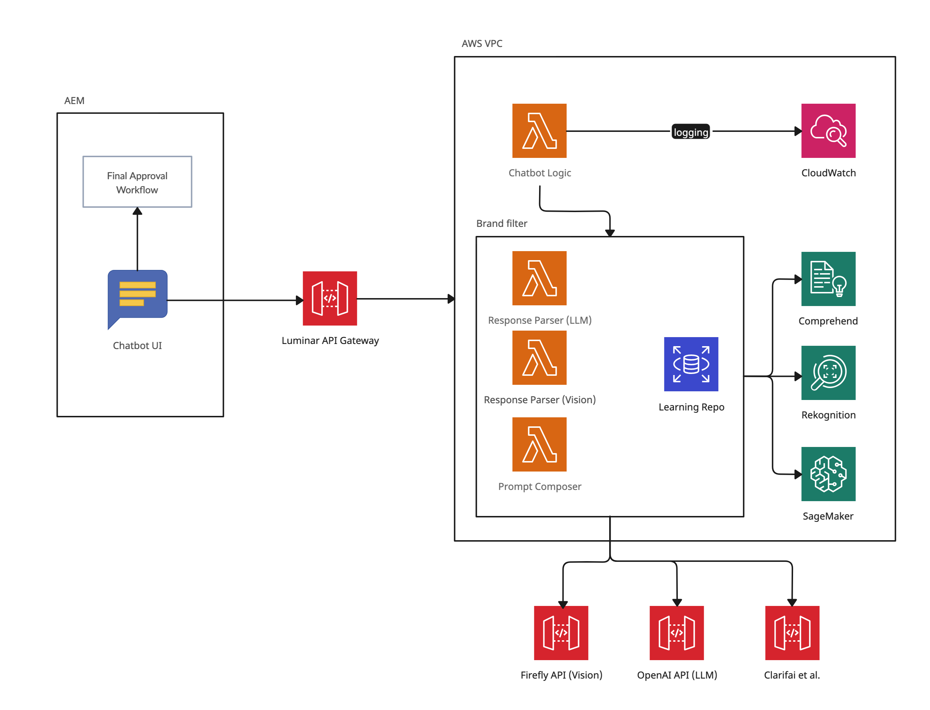
Proposed Architecture & API Management

Slide 31
Brand Filter Training Strategy

Slide 32

Brand Filter Training Strategy
Define Specific Criteria:
Clearly outline what constitutes acceptable and unacceptable content for your brand
Select Appropriate APIs:
Choose APIs that align with your content types and moderation needs.
Integrate and Test:
Implement the selected APIs into your system and conduct thorough testing to ensure efficacy.
Monitor and Iterate:
Continuously monitor the performance and update your models as needed to adapt to new content trends.
Notes:
Define Specific Criteria
We will need to have Luminar style guides and any other brand guidelines
Select Appropriate APIs
Firefly (vision)
OpenAI (LLM)
Amazon Rekognition & Amazon Comprehend (AWS)
Use Case: Detects inappropriate images, text, and sentiment in user-generated content.
Features: Image moderation, entity recognition, sentiment analysis.
Integration: Seamlessly integrates with AWS services.
Amazon SageMaker
AWS’s machine learning platform, which you can use to train, fine-tune, and deploy custom LLMs.
Supports a wide range of pre-trained models through the Hugging Face Model Hub (including GPT, BERT, T5, and more).
Offers a fully managed environment for training, deploying, and scaling LLMs.
Clarifai
Use Case: Customizable image and text moderation tailored to specific brand guidelines.
Features: Trainable models with user-friendly interfaces.
Integration: Offers APIs for easy integration.
Qloo
Use Case: Provides cultural and taste-based recommendations across various domains.
Features: Analyzes user preferences to offer personalized suggestions.
Integration: APIs available for integration into applications.

Slide 33
Q&A and Demo

Slide 34
Closer Slide

Slide 35
Closer Slide

Slide 36
Closer Slide

Slide 37
Things I’d like to have done better

Slide 38
Things I’d like to have done better
Additional routes in the code to:
Generate images from a sample
Demo generative fill capabilities
Generate on-brand copy from a sample image
Include a feedback feature so that Firefly can learn from what I’m seeing
“more like this”
“that child’s eyes are not closed”

